Slide 1
ADVANCED JAVA PROGRAMMING SEMINAR
- TEAM 3

Slide 2
PROGRAM-8
Create a catalogue page containing the book’s details like: cover image, book name, authors, description, price and an Add to Cart button. Also create a cart page which shows details like: book name, price, quantity, amount and total amount to be paid. Using JSP display the content in the cart page dynamically by retrieving the data from sessions.

Slide 3
STEPS INVOLVED:
Creating a database with tables for cart, books and author
Creating a catalog page that shows the books and their details
Along with the add button
Creating a cart page where the user enters the quantity needed and gets the total amount to be paid

Slide 4
SOFTWARE USED:
NETBEANS
APACHE TOMCAT
NETBEANS
PHPMYADMIN
BROWSER

Slide 5
CODES:

Slide 6
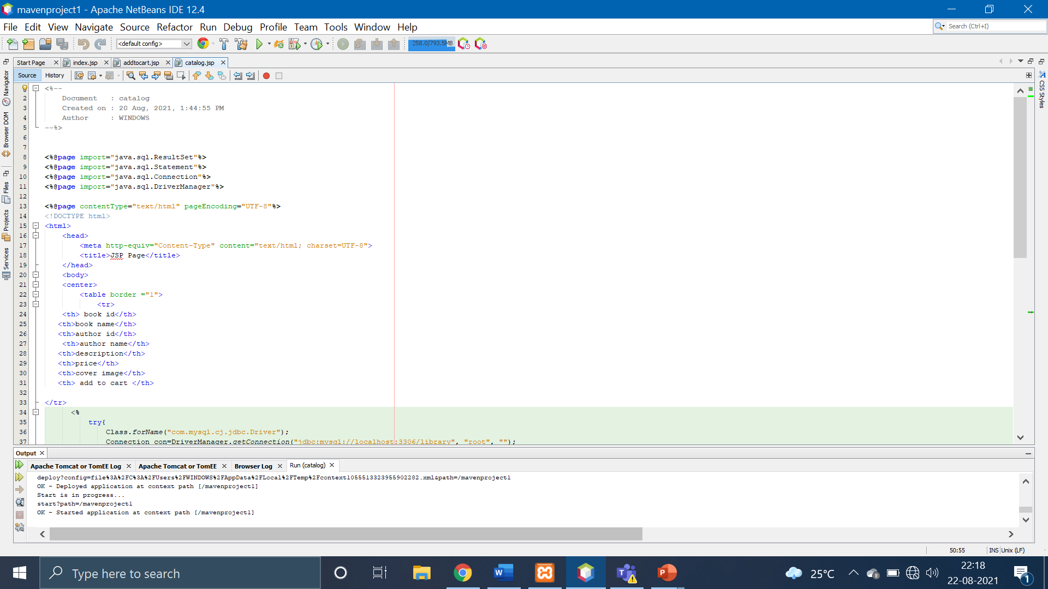

Slide 7
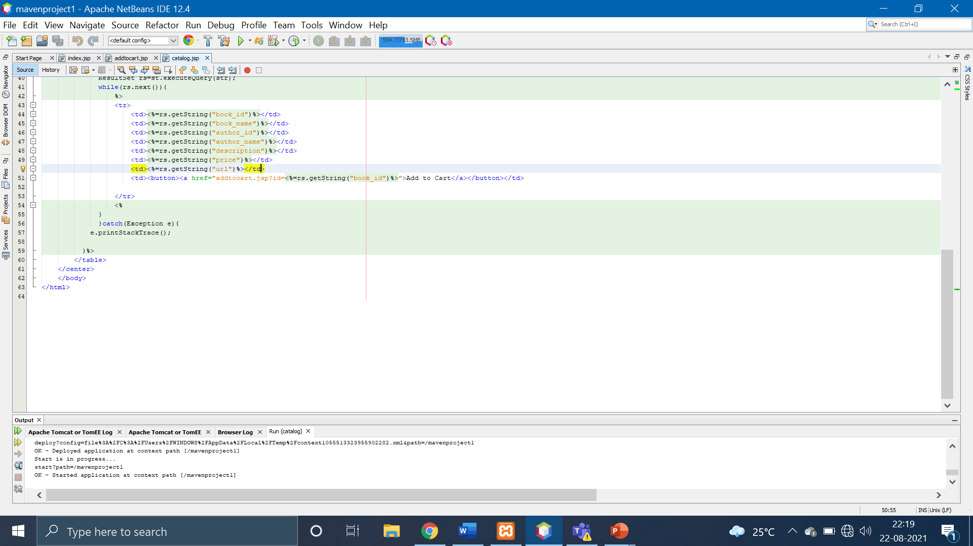

Slide 8
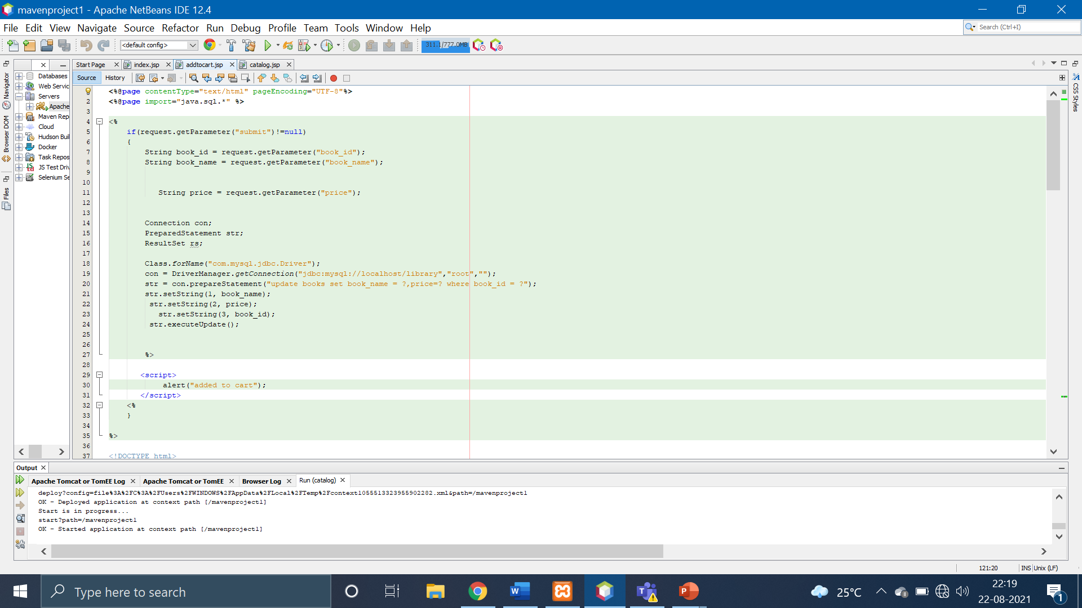

Slide 9
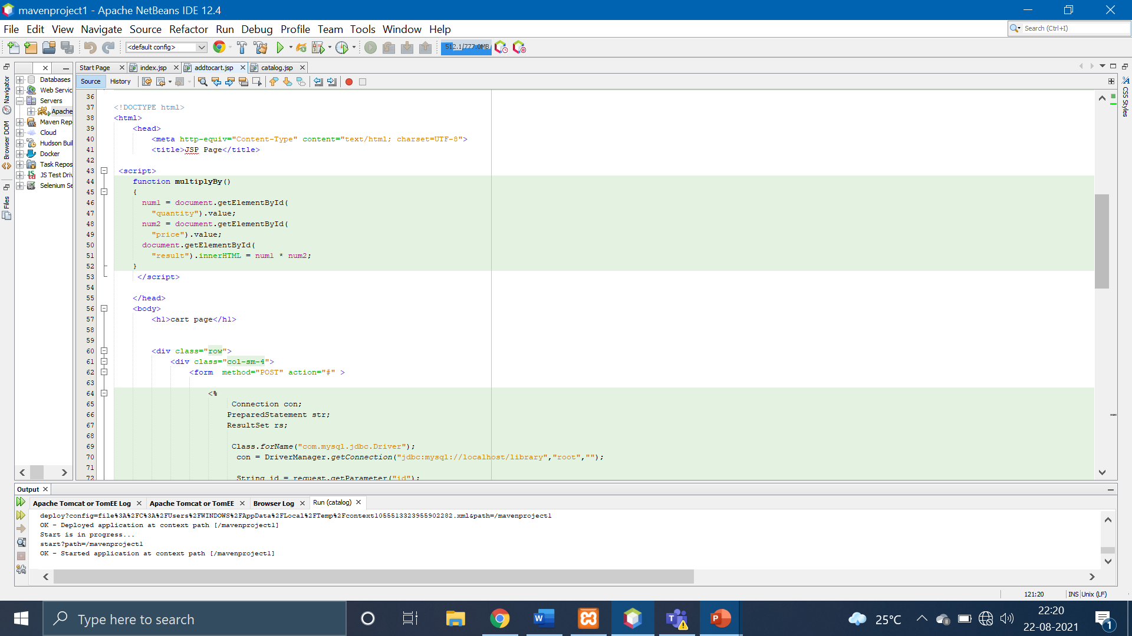

Slide 10
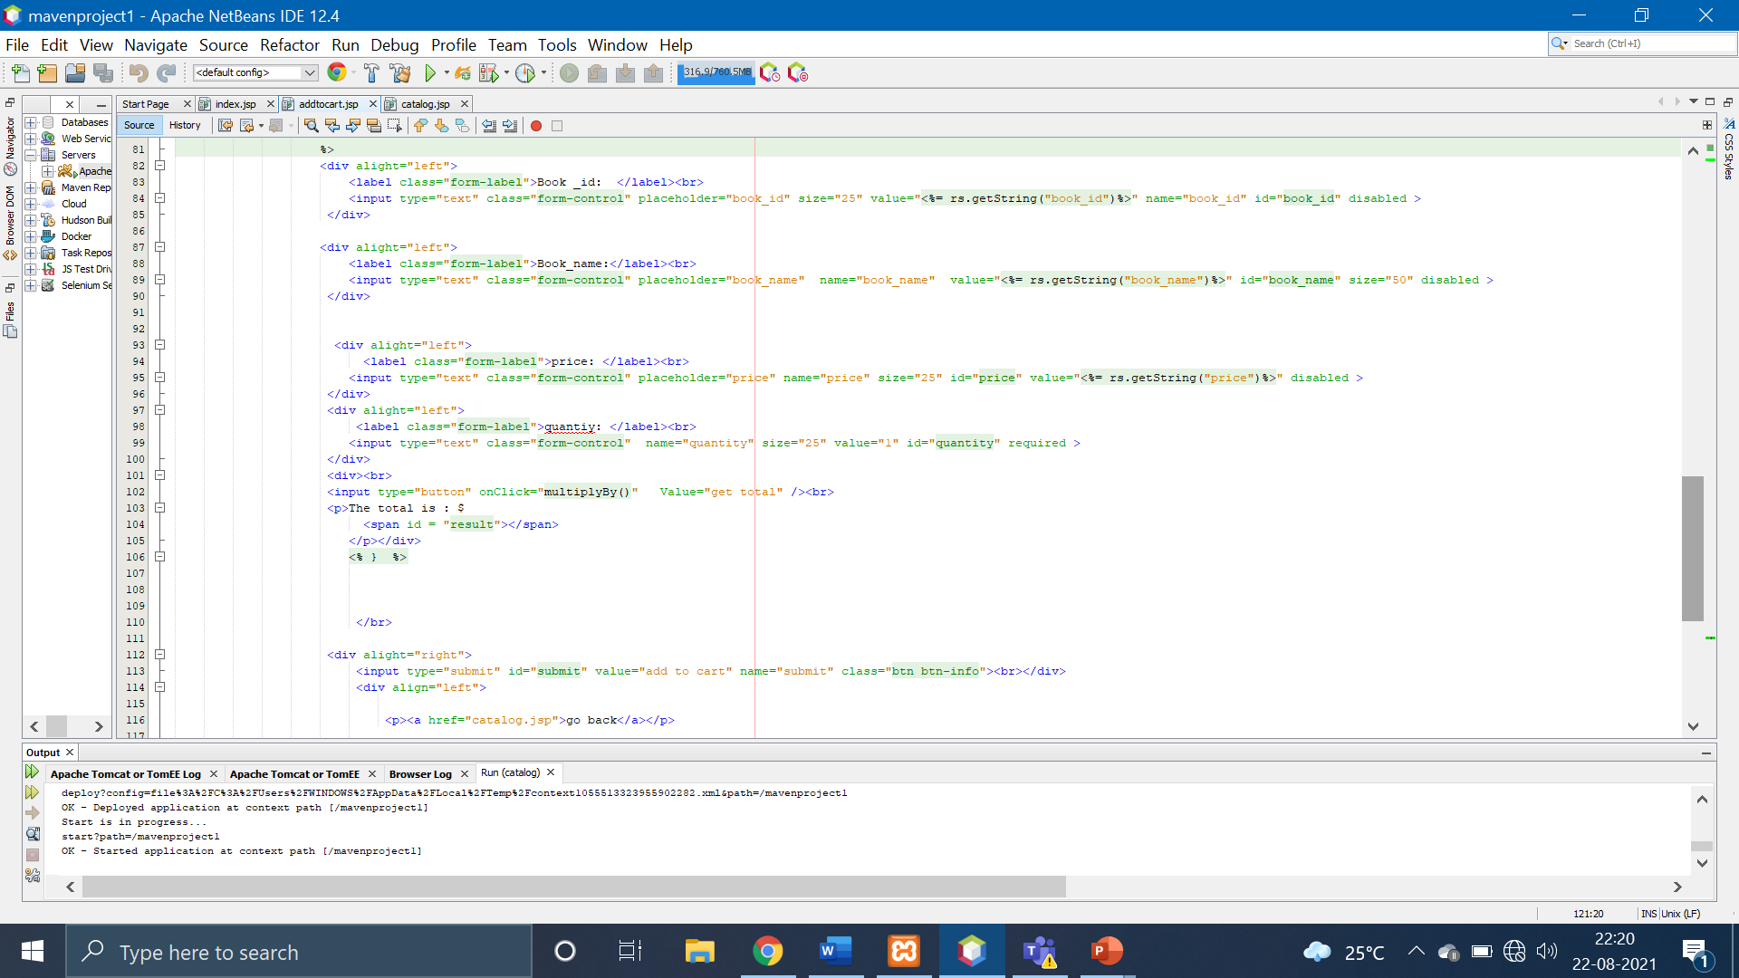

Slide 11
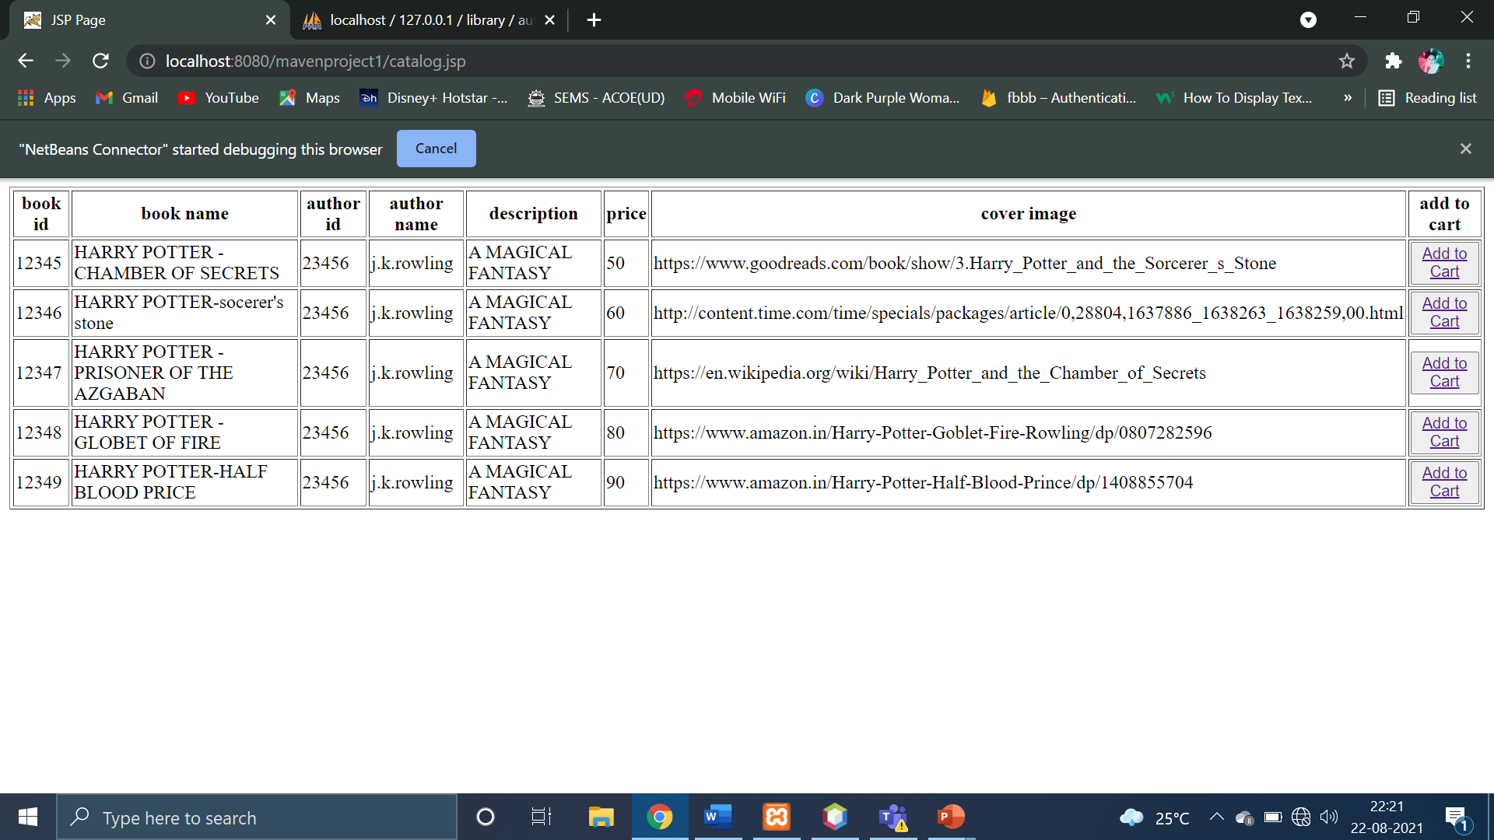

Slide 12
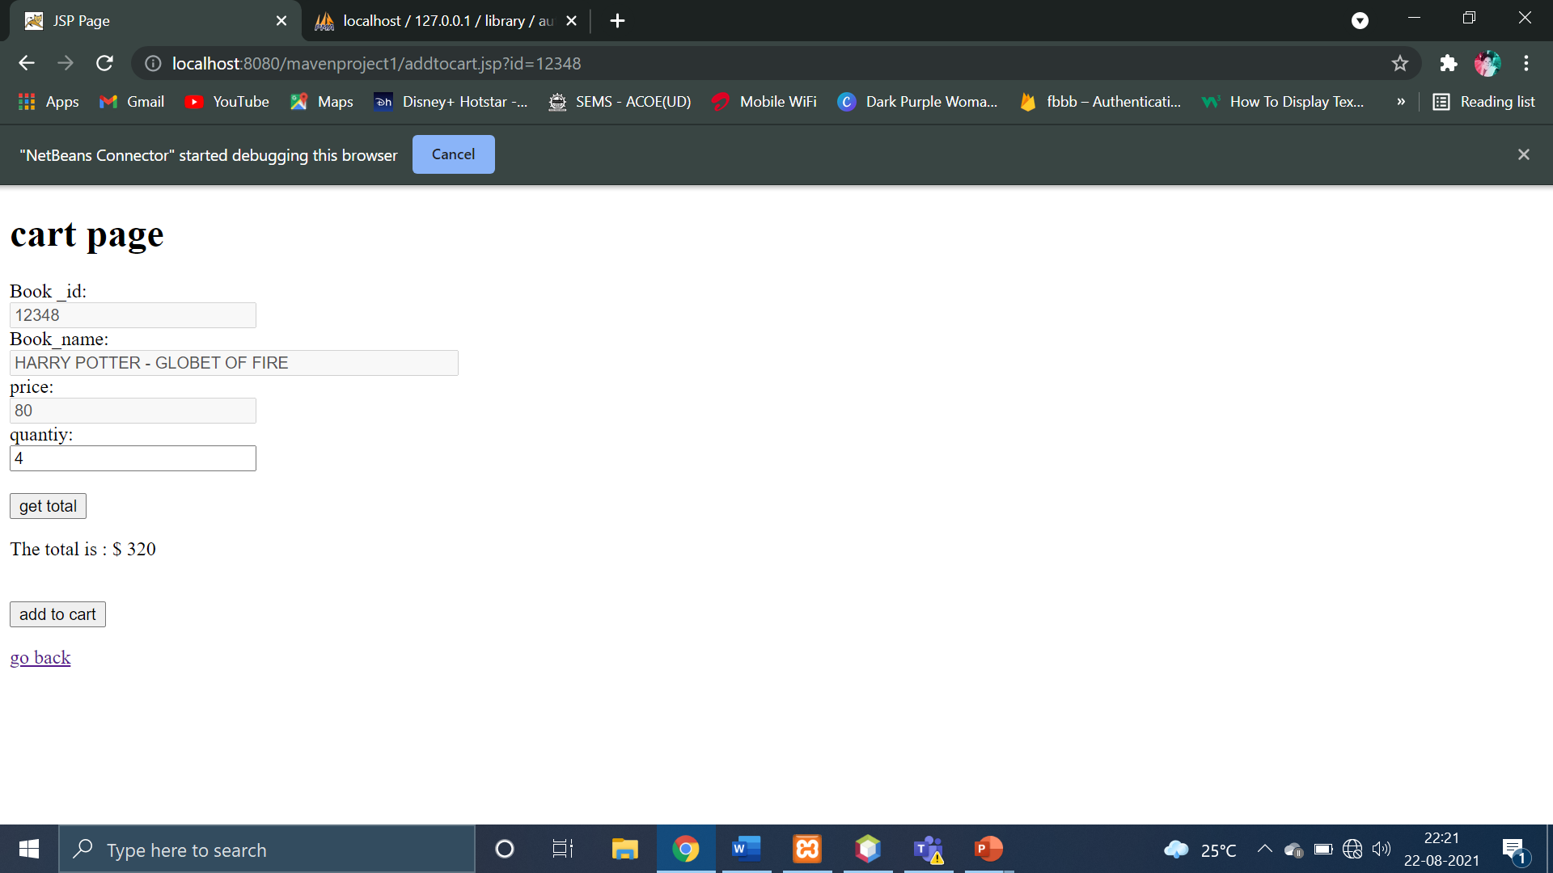

Slide 13
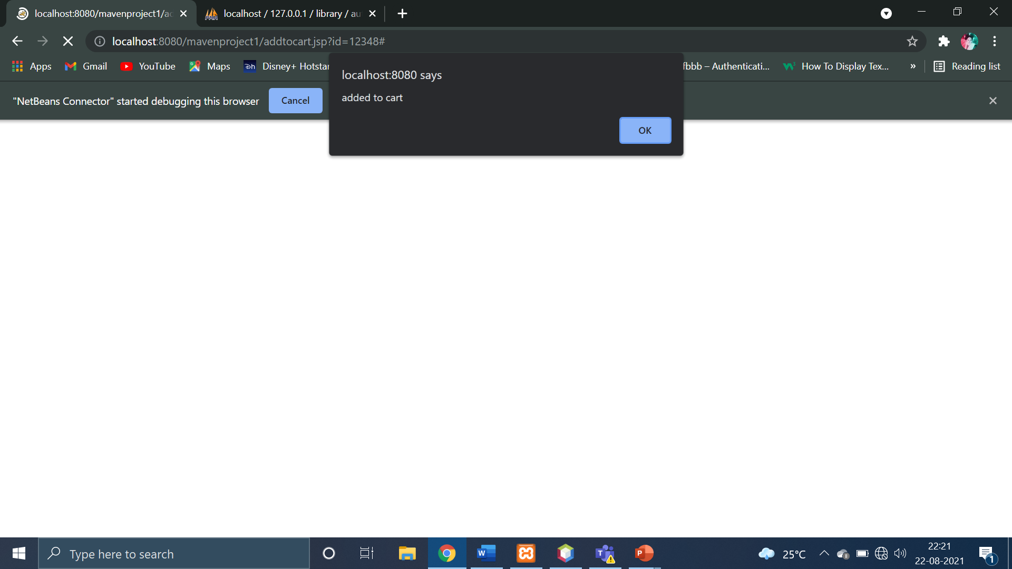

Slide 14
THANK YOU!

